Slide 1
SYSTEMS DEVELOPMENT and MODERN DATABASE PRACTICES
CIS020-2 Lecture 9: Interface Planning

Slide 2
Today’s schedule
Main Differences in Architectures
User Roles
Navigation
Mapping
Interface
In Class Activities
Next week – assignment updates
Feedback

Slide 3
Web DB Design Context
Web Page Design
Data representation
Data association
Interface design

Slide 4
Web DB Design Process
Requirements
REQUIREMENTS CAPTURE
USER ROLES IDENTIFICATION
CONCEPTUAL DESIGN
NAVIGATION DESIGN
MAPPING DESIGN
INTERFACE DESIGN
IMPLEMENTATION
TESTING
User Roles
Conceptual
Navigation
Mapping
Testing
Interface
Implementation

Slide 5
User Roles
Part of the functional requirements
A user must be able to browse
A user must be able to register
A user must be able to update/delete his/her profile
A user must be able to see his/her history
Identify/classify different user roles:
Public
Private
Control
User roles maybe associated with the R&W privileges

Slide 6
5’ Activity
Most Web DB sites offer a 3-view user role (Public/ Registered/Administrator). Can you think of a Web DB service that offers 3- or more user roles?
Some common roles include
Standard user (Public)
Content Contributor
Content Editor
Content Manager
Administrator
Content Developer

Slide 7
5’ Activity
Select a Web site/Web portal of your choice
List potential requirements for each user role
Role1 (……………)
Role2 (……………)
Role3 (……………)
Role4 (……………)
Role5 (……………)

Slide 8
Navigational Context
TOP-DOWN method: TOP=Simplified version
Map users based on their role
Novice & Experienced Users
Allow progress
Routing should be not complicated
Keep Consistency & Complexity
User with multiple roles
Use a cache service

Slide 9

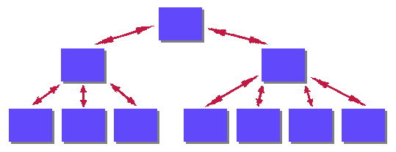
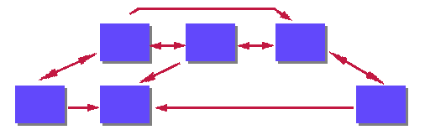
Linear/Hierarchical/Non-Linear
Linear
Hierarchical
Hierarchical Non-Liner

Slide 10
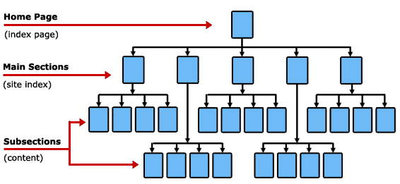
Hierarchical Navigation Map

Slide 11
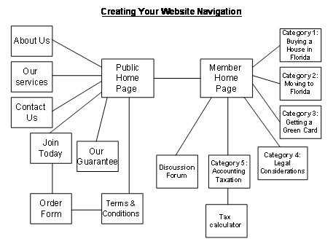
Navigational Plan: Different Roles

Slide 12
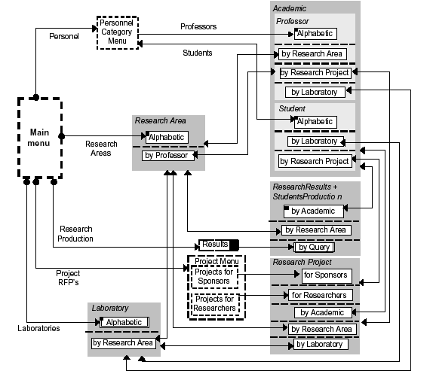
Navigation Plan: University
Notes:
RFP’s = Request for Proposal

Slide 13
Mapping Design
How the navigation plan relates to the database:
Entities
Attributes
Start to build up detail on Navigation Map
Think of mapping:
Data types
Text fields
Text areas
Drop-down menus
Single or multi-selections
And/or
Specific values: =, <,>, contain, between

Slide 14
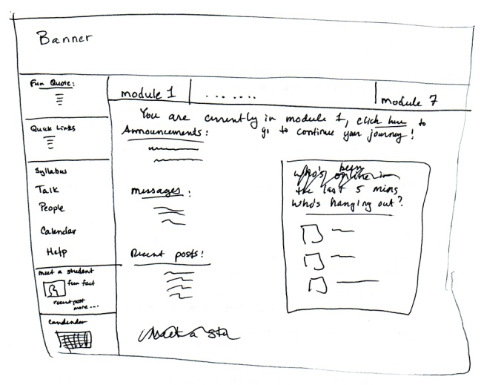
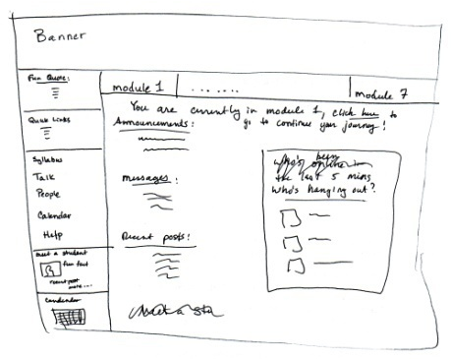
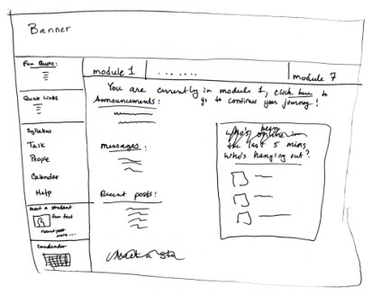
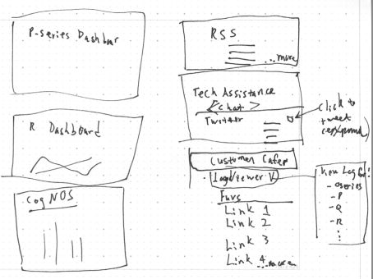

Mapping Design

Slide 15
Privileges
Decide the R&W privileges for each user role
CREATE
DELETE
MODIFY
Create Unit
Delete Unit
Modify Unit
Entity
Entity
Entity

Slide 16
15’ Activity
Split in groups of 3 and prepare a navigation map for:
A new customer looking to order a book at Amazon website
Your map should consist of a set of square boxes where each square box = a web page.
Each box should have a title (i.e Log in page) & illustrate:
The relationship with other pages (hyperlinks)
The information shown on the page
Where these are coming from (entities: attributes)
The type of mapping (i.e. data type, drop-down, =. Etc.)
Whether they are dynamic (D) or static
Whether they are client (C) &/or server (S) interactions
Whether they are read (R) or write (W)
The user roles (P=public, A=administrator, R=registered, etc…) in which the page will be available to

Slide 17
INTERFACE DESIGN
Customisation v Personalization: What’s the difference?
Customisation
Explicitly specify what you want
Choosing what info on homepage
Choosing colour scheme
Layout
My Google is an example
Personalisation
Intelligently adapts information
According to interests
User actions/what you buy
What you browse

Slide 18
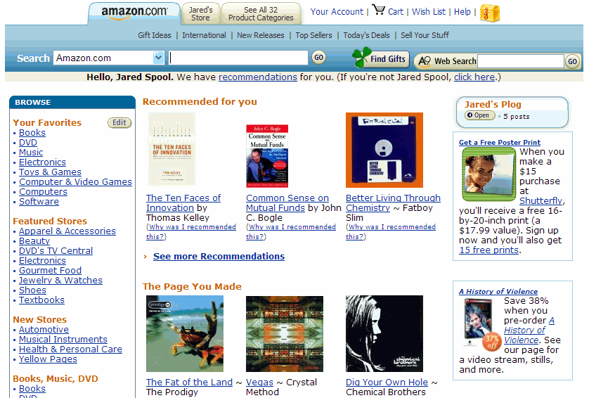
Personalisation

Slide 19
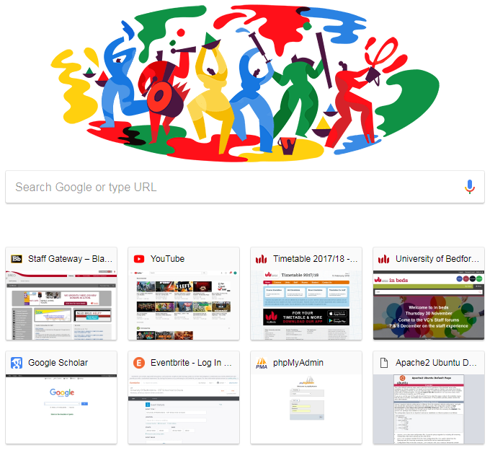
Personalisation

Slide 20
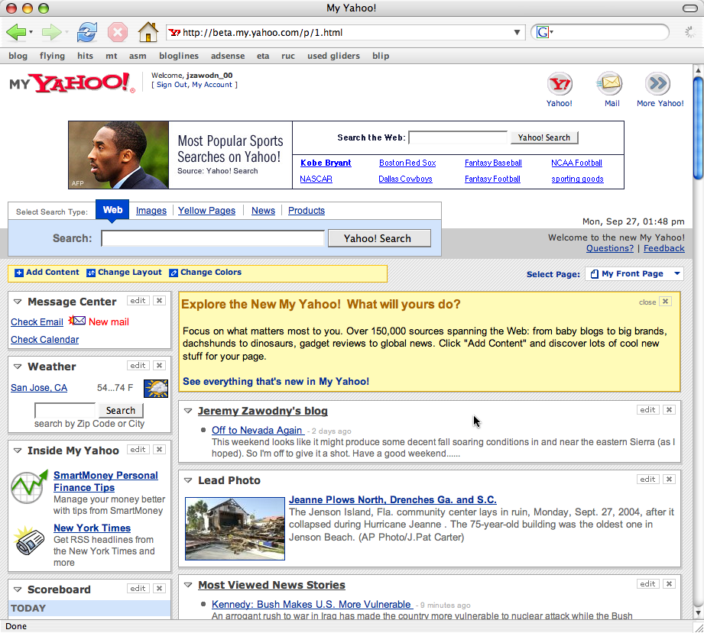
Customisation

Slide 21
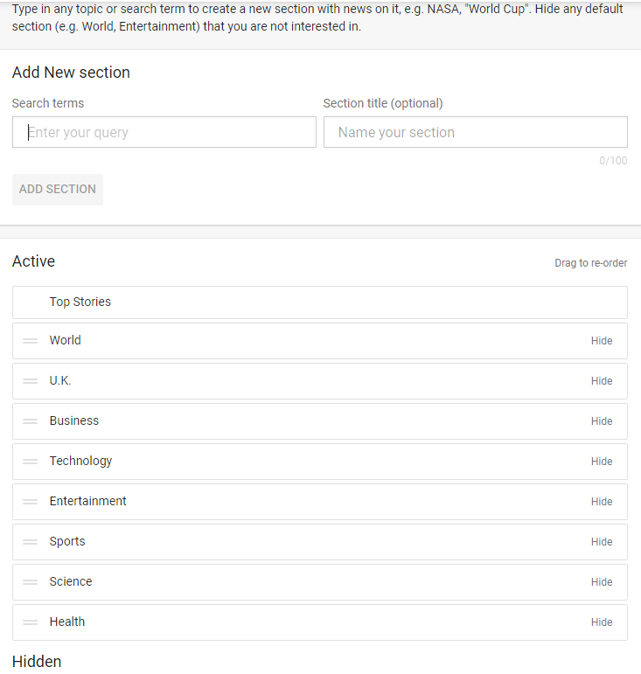
Customisation (google news)

Slide 22
INTERFACE DESIGN
Screen Layout
Characters on screen
Graphics on screen – appropriate for all users?
Arrangement of information
Amount of information
Colour scheme – colour blindness
Terminology
Literacy levels
Domain knowledge
Functionality
Speed
Error handling

Slide 23
Observational activity
http://www.expedia.co.uk/
http://www.lutontoday.co.uk/
http://www.google.co.uk/

Slide 24
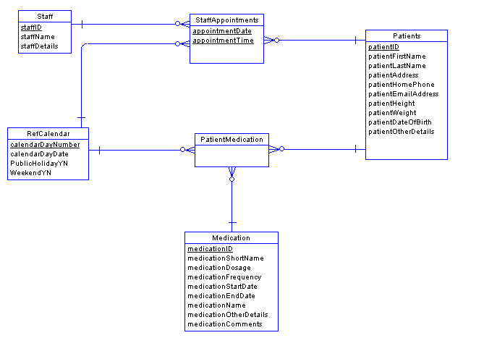
In class activity:
Use the following ERM to identify the 2 user roles and to produce the Navigation/Mapping diagrams for each role

